Slide 1

St. Francis School
Mackay Street, Thames
Ph: 07 868 7655
Fax: 07 868 9214
E-Mail: office@stfrancis-thames.school.nz
2024-25 Strategic and Annual Implementation Plan
2025

Slide 2
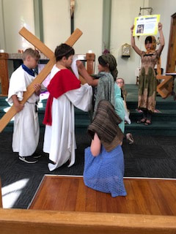
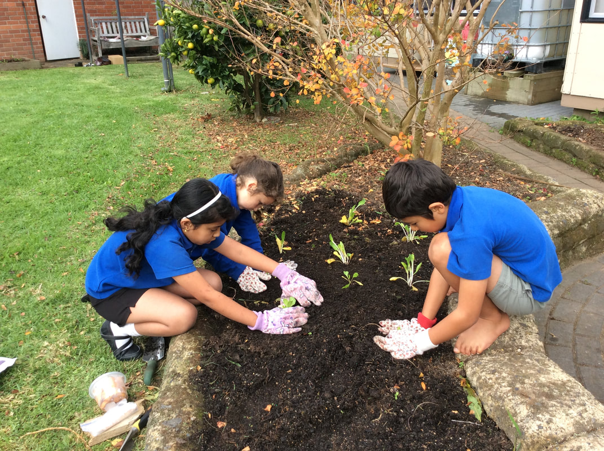
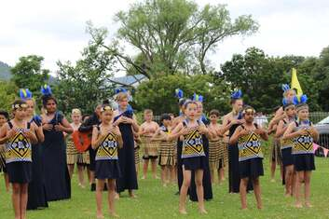
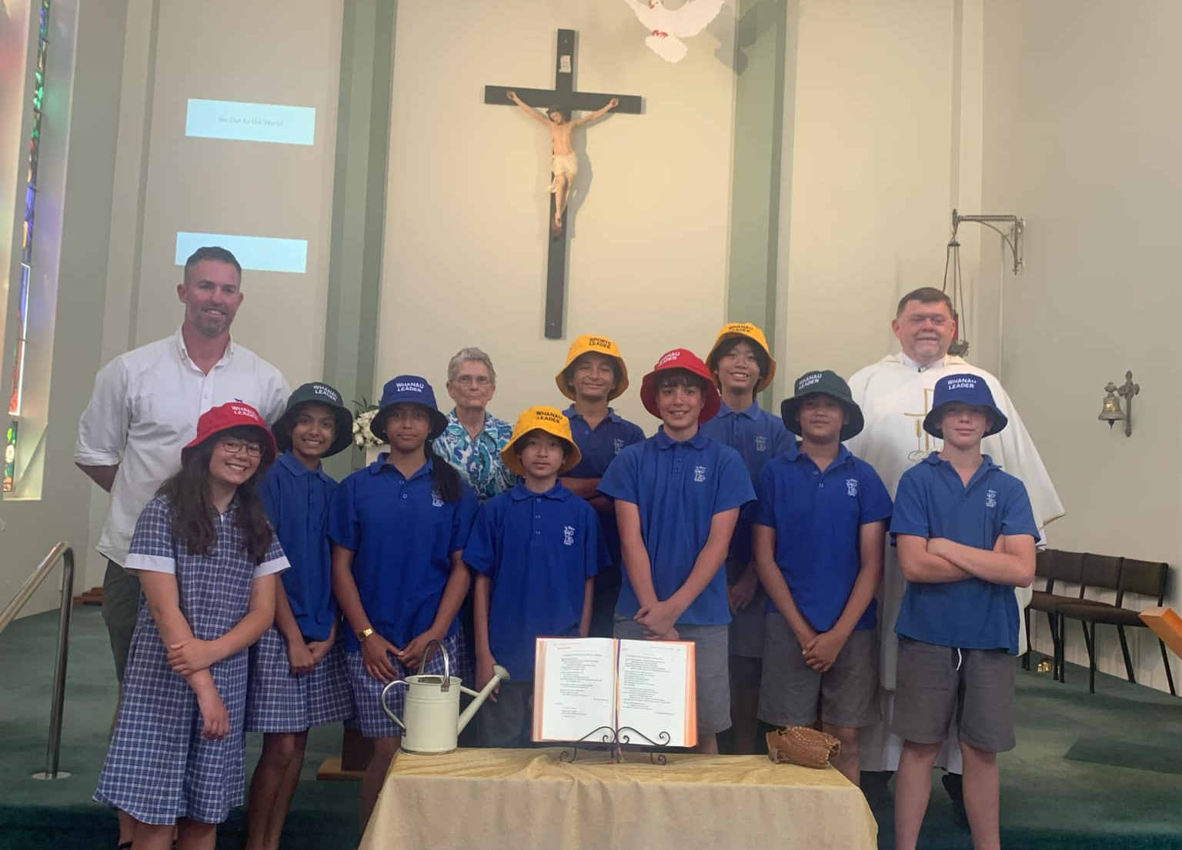
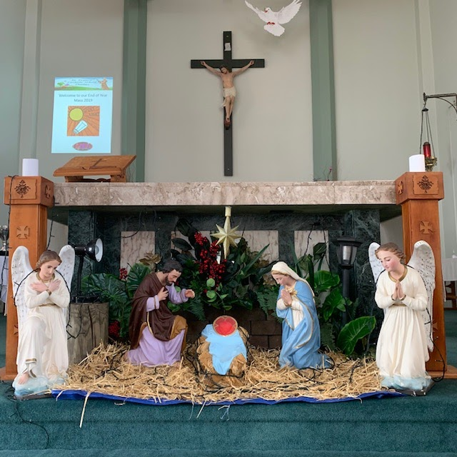
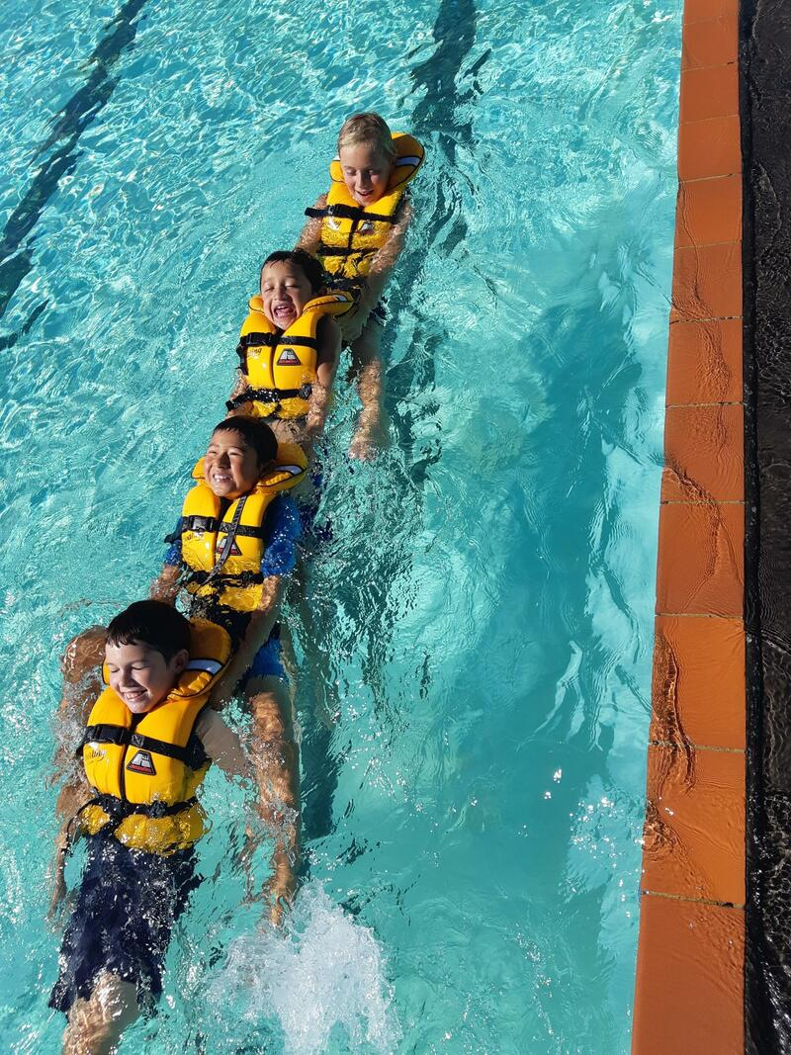
Vision:
Learning to Love - Loving to Learn.
ako ki te aroha, te aroha ki te ako
Mission:
A catholic faith community committed to quality learning.

Slide 3

Gospel Values ~ School Values
Our School Values come from the Gospel and help us to live our faith through our
words and actions.
Love Jesus replied: “Love the Lord your God with all your heart and with all your soul and with all your mind.' This is the first and greatest commandment. And the second is like it: 'Love your neighbour as yourself.‘ Matthew 22:37 -We Love God with all our mind, body and souls. -We put the needs of others before our own. -We forgive others that have done us harm. -We love and care for God’s creation. Social Justice Teaching: HUMAN DIGNITY | TE MANA I TE TANGATA - We are beautifully made in the image and likeness of God. PREFERENTIAL OPTION FOR THE POOR AND VULNERABLE | HE WHAKAARO NUI MO TE HUNGA RAWAKORE - The needs of the poor and vulnerable should be put first | Respect ‘Just as you did it to one of the least of these, you did it to me’ . Matthew 25:40 -We are all made in God’s image and His love. -We actively listen to others and show empathy. -We use our manners at all times. -We are grateful for the blessings in our life. COMMON GOOD | HE PAINGA MA TE KATOA - We are called to work for the good of each and of all. PARTICIPATION | NAU TE ROUROU, NAKU TE ROUROU - We all have the right and duty to participate fully in society STEWARDSHIP | KAITIAKITANGA - We are kaitiaki of God’s creation, living sustainably and enhancing the well-being of our planet.
Faith "For nothing will be impossible with God." — Luke 1:37 -We give everything a go and persevere when things are hard. -We learn about God and His word. -We live our faith through Prayer and sacraments. -We share our faith in God with others. SOLIDARITY | WHAKAWHANAUNGATANGA God created us as one global family called to support our brothers and sisters. PROMOTION OF PEACE | TE WHAKATAIRANGA I TE RANGIMARIE We can be God’s instruments of peace through seeking justice | Truth Jesus answered, ‘I am the way and the truth and the life. No one comes to the Father except through me. John’ 14:6 -We know the difference between right and wrong. -We follow in Jesus footsteps to live in truth. -We show honesty and integrity in our words and actions. -We act and play with humility and grace. SUBSIDIARITY | MANA WHAKAHAERE - We are called to empower communities, to let everyone have a say. DISTRIBUTIVE JUSTICE | TE TIKA KA TOHAINA - Everyone should have access to their fair share of resources.

Slide 4

Principles
Foundations for Curriculum decision making.
The St. Francis school curriculum is based on the following principles.
Integrated Faith Learning
  The curriculum will centred on the foundation that Christ is the reason for our school and faith learning is woven into all aspects of school life.
Treaty of Waitangi
  The school curriculum will reflect the faith belief that the treaty is a covenant – a promise made to God, and so we are called to honour the intent of the Treaty.
Cultural Diversity
  The lives, traditions and stories of the various cultures and ethnicities of our school are celebrated and reflected in our practices and in our curriculum.
Inclusion
  Our curriculum will reflect our belief that all people are made in the image and likeness of God. It will allow ALL children to find success and celebrate the differing talents and strengths of our learners.
Equity in Learning
  We believe ALL children should find success in learning irrelevant of their background or learning needs.
  Learning contexts are relevant, meaningful and within reach of all children
Community Engagement
  The curriculum will have relevance to the children’s lives and it will be enhanced by the inclusion of the wider community.
Coherence
  The curriculum will support children to see the interweaving of learning areas and themes leading them to make pathways to further learning.
Future Focus and Sustainable Community
  Children will be led to an understanding that the actions they take have an impact on society and our environment.

Slide 5
Effective Pedagogy requires that teachers are learners, continually reflecting on the impact of their teaching on their students learning.
Teachers understand that students learn most effectively when…
  There is an understanding that all children are different and possess different skills and gifts.
  Positive relationships are present between akonga, kaiako and whanau.
  Positive behaviour management is used at all times and the dignity of all parties remain intact.
  Learning opportunities are engaging, relevant and allow ALL akonga to succeed.
  Students understand what they are learning and why they are learning it.
  Children are able to integrate new learning with what they already understand.
  They have the opportunity to engage with practice and transfer new learning across all curriculum areas.
  ‘E’ learning will be used as a learning tool to supplement traditional ways of teaching when appropriate.
  The learning opportunities provided are relevant, engaging and allow all children to experience success.
  They recognise the potential for giftedness and provide opportunities for development.
  When they feel emotionally and socially safe.

Slide 6

St Francis Annual Implementation Plan, 2025
This Annual Implementation plan has been created to ensure St Francis School continues to offer the best possible education for our children and community. The goals in this plan reflect and have been prioritised using the following elements:
-The New Math's and Literacy Curricula.
-New regulations around the delivery of Structured Literacy and Mathematics and the mandated 1 hour a day.
-Student achievement data across the school.
-Staff, Parent, whanau, Parish and community voice.
-Alignment with our Education Review office goals and Profile report and Catholic review goals.
-The rolling out of the new Catholic Curriculum – Te tataou whakapono.

Slide 7
Strategic Aim |  | Link to NELP |  | How will we achieve these goals? | Measure of Success
Strategic Goal 1 – Special Character: Christ, His teachings and our Catholic faith are woven through all aspects of school life.
Religious Education and living our Faith: R.E achievement objectives, Gospel Values, Social Teaching and our Charism are weaved through all learning areas bringing us to a closer relationship with Jesus Christ b. Worship, Evangelisation and Catholic Community: True evangelization and sense of community through meaningful relationships, Christian witness and encounter. | -Staff have access to quality Religious Education professional development particularly around the new curriculum. -Implement Level 1 and 2 of the new Religious Education curriculum for Years 0-4. -Training for Years 5 and 6. -Start to integrate aspects of the new curriculum such as Prayer across the whole school. -Combine with our Parish for as many activities and events as possible such as Combined Gala’s and Cultural shows. |  |  |  | -The New Religious Education curriculum – Te tatou whakapono is being effectively implemented and integrated across the wider school curriculum. -Staff regularly undertake quality Religious Education Professional Development. -Parish and School are one.
Strategic Goal 2: The highest quality Teaching and learning of a rich and relevant curriculum where all children find success in a nurturing learning environment.
Teaching and Curriculum Teachers collaboratively build, consolidate and implement sound teaching practice across a rich and engaging curriculum. Raising Student achievement Raise achievement levels in all curriculum areas with an emphasis on implementing the new Math's and Literacy curricula. Embed the focus on Structured Literacy approaches across the school to improve Literacy outcomes. Well Being and Learning support: Ensure ALL children are supported to succeed in learning in a safe and nurturing environment | Ensure places of learning are safe, inclusive and free from racism, discrimination and bullying 4 Ensure every learner/ākonga gains sound foundation skills, including language, literacy and numeracy. 3 Reduce barriers to education for all, including for Māori and Pacific learners/ākonga, disabled learners/ākonga and those with learning support needs. 5 Meaningfully incorporate te reo Māori and tikanga Māori into the everyday life of the place of learning. | Ensure places of learning are safe, inclusive and free from racism, discrimination and bullying 4 Ensure every learner/ākonga gains sound foundation skills, including language, literacy and numeracy. 3 Reduce barriers to education for all, including for Māori and Pacific learners/ākonga, disabled learners/ākonga and those with learning support needs. 5 Meaningfully incorporate te reo Māori and tikanga Māori into the everyday life of the place of learning. |  | Structured Literacy Professional development for all teachers through Cohort 3 ‘IDEAL’ Literacy program. Ensure effective learning support for students with special learning needs. | -Writing achievement levels are in line with those of Reading and Maths. -Teachers have a sound understanding of structured literacy and are able to embed this into their teaching practice. -Planning and Teaching are done in response to the strengths and needs of akonga.
Strategic Goal 3 –Learning Community - Working in partnership to provide the best possible learning outcomes for our children and community.
Whanau and akonga understand what they are learning, how they can help at home. b. Whanau have a sense of belonging, Our cultural diversity is acknowledged and celebrated. Connect To our local community and environment. | 2 Have high aspirations for every learner/ākonga, and support these by partnering with their whānau and communities to design and deliver education that responds to their needs, and sustains their identities, languages and cultures | 2 Have high aspirations for every learner/ākonga, and support these by partnering with their whānau and communities to design and deliver education that responds to their needs, and sustains their identities, languages and cultures | Rregularly meet with whanau and effectively communicate learning progress and needs. Consistently seek voice from whanau and include whanau as much as possible in the life of our school | Rregularly meet with whanau and effectively communicate learning progress and needs. Consistently seek voice from whanau and include whanau as much as possible in the life of our school | -Whanau are clear on what their children are learning at school and how they can help at Home -Our diversity of cultures are celebrated and whanau voice shapes school decisions

Slide 8
Raising Student Achievement Action Plan for 2025
Strategic Goal (As per your strategic plan) The highest quality Teaching and learning in the context of a rich and relevant curriculum where all children find success in a nurturing learning environment. Regulation 9(1)(a)
Annual Target/Goal: Raise achievement levels in all curriculum areas with an emphasis on raising Writing achievement levels through structured Literacy approaches. Ensure ALL children are supported to succeed in learning in a safe and nurturing environment.
What do we expect to see by the end of the year? Improved Achievement across the school, positive attitudes towards Literacy and the Development of a robust and engaging Literacy program supported by Teachers Professional learning. Regulation 9(1)(d)
Actions Detail the key actions you’ll take this year to reach your annual target listed above Regulation 9(1)(b) | Who is Responsible Regulation 9(1)(c) | Resources Required and Actions needed. Regulation 9(1)(c) | Timeframe This is optional however is useful to help with your planning | How will you measure success? Regulation 9(1)(d)
Raising Student achievement Raise achievement levels in all curriculum areas with an emphasis on implementing the new Math's and Literacy curricula. Embed the focus on Structured Literacy approaches across the school to improve Literacy outcomes. | Principal, Teachers, PD providers | Time dedicated to Professional development staff meetings – Literacy PLD release is MOE funded – Cohort 3. Maths No Problem Resources both hard copy and online(MOE funded) purchase on new Maths materials. Analyse student data and inquire into ways to accelerate learning progress in Literacy. | Term 4, 2024 | Compare end of Year Maths data and teacher capability and compare with previous years. Gather Student/Teacher/parent voice around Mathematics
Regular and collaborative planning to ensure consistency in understanding and quality teaching | Principal Teachers Curriculum Lead teacher. | Time to ensure teachers regularly plan together and are able to undertake observations of each other. lead teacher who promotes and models good practice across the school. | Term 4, 2024 | Teachers have are able to express a common understanding of what good Maths teaching and learning looks like and are able to put this into practice. Reflection of class observations.
Use quality formative assessment to inform teaching and learning. | Principal, Teachers, IDEAL and Maths No Problem PLD providers | Ensure formative and summative assessment shapes learning programs and experiences with an emphasis on implementing new Literacy assessment practices. | Term 4, 2024 | Growth in teachers ability to formally assess students learning to inform planning and teaching. Increased confidence in teachers ability to cater for different learning needs.

Slide 9
Growing a stronger faith and relationship with Christ through the Spirituality, Charism and history of St Francis of Assisi School, Thames
The particular charism and spirituality of our school covers almost 150 years of Catholic education in Thames.
9 years Franciscan spirituality – Providence of God/care for the earth and creation.
30 plus years Lay Spirituality – love of the church, respect, care and concern for Family.
37 years Mercy Spirituality care for the poor and those on the margins of society.
75 years Josephite Spirituality –education for all, particularly for the underprivileged.
5 years Dominican Spirituality Promotion of truth.
8 years Marist Spirituality -Living as a community, being missionary in outlook
We ensure that this continues to be nurtured by …
Conservation and environmental awareness integrated into our curriculum. Green Gold Enviro-school status – we are living our school charism through protecting and cultivating our local environment towards sustainable living
Involvement in the community- following the tradition established by Father Nivard who was one of the founders and the first Secretary of the Thames Hospital – Lay charism. Evangelization – Encouraging Baptism and whanau to join RCIA, non-preference children/ families becoming Catholic.
Justice – strength of the Sisters of St Joseph, settling of differences, emphasis on working towards a just solution in particular for the rights of children and families and the poor and marginalized. Food collections for local Thames Baptist food bank
Environmental sustainability is part of all our decisions and everything we do.
How does it connect with our local area?
The Coromandel area is known for its environmental awareness –a strong sense of being kaitiaki of our environment
There is a ruggedness and determination to better conditions in the typical Thames persona. A care of the Earth / of all creation.
Prior to the Education Act 1877 the people of Thames prized education as a right for their children, this was evident in the setting up of the three schools by Father Nivard as early as 1874.

Slide 10
Our Special Character
The strengths and successes of St Francis School attributable to its special character are …
Parents/Caregivers and Parish support and contribute to our school’s special character by …
… The staff ensures that this special character is integrated into the whole curriculum and is a valued part of life at St Francis.…
An aspect of the Special Character of the school underpins the ‘big idea’ or theme and permeates all other curricula topics for the year.
Expectation of excellence in all endeavours- academic, sporting and cultural
Parents/Caregivers and parishioners attend School Masses and Liturgies
Education seen as a partnership between school and parents/caregivers – interviews, classroom assistance, school trips.
Class prayer, Assembly and Liturgies, grace before meals are an integral part of the school day – a part of who we are and the culture of the school!
Positive and meaningful relationships with children and whanau.
Celebration of special feast and Holy days that connect with our school. Whanau included in celebrations
Support for RE programme from parents
Interaction with other adults and students based on the knowledge we are each precious in the sight of God and made in His image,
The high standard of the behaviour of our children reflecting our school and Gospel Values.
Parents/Caregivers concern and care for each other
Positive behaviour management with an emphasis on our school values. A focus on reconciliation and restoring of mana when . The human dignity of all remain in tact..
A Family/whānau culture within the school
Staff support and promote the sacramental programme
Parents/Caregivers willing to undertake roles within the school BOT, Prop Reps, PTA
School Whanau groups system – Chanel, Pompallier, MacKillop, Nivard, Children all belong to one of our whanau groups.
2017 Awarded the Green- Gold Enviro-School Status.
That all gifts are valued.

Slide 11
School Operations, Governance and Management
Curriculum
Key documents that support the St Francis School Charter relating to curriculum include:
Refreshed New Zealand Curriculum
Religious Education Curriculum – Te tatou Whakapono
Curriculum policies and implementation plans
Planning and assessment documents include achievement expectations, assessment map, timetable and plan, RE plan for year, Big Idea focus for the year and Term.
NELPS
Curriculum and associated policies
Strategic plan and annual Implementation plan.
Catholic Education of School age Children document.
People
Key Documents that support the St Francis School charter relating to people.
Job Descriptions
Performance Agreements
Staff and Principal Proffesional Growth cycles
Staff Professional Development
Roles and responsibilities
Accident and Medicine Registers
Personnel and Curriculum Policies
Strategic Plan
Annual Plan
Board of Trustees job descriptions and responsibilities
Police Vetting
E-learning – devices parental consent
Visitors Book

Slide 12
School Operations, Governance and Management
Finances
Key documents that support the St Francis School charter relating to finances include:
Annual Budget
10 year property plan
SUE Reports
Bank Staffing Reports
Assets Register
Auditor report
Associated Policies and Procedures
Strategic plan
Annual Plans
Property
Key documents that support the St Francis School charter relating to property include:
10 Year property plan
Cyclical Maintenance Schedule
Hazards register
Health and Safety Register
Evacuation procedures
Insurance
Associated Policies
Strategic Plan
Annual Plan
Health and Safety
Key documents that support the St Francis School charter relating to health and safety include:
Strategic plan
Annual plan
Hazards register
Health and Safety register
Maintenance Schedule
Evacuation procedures
Associated Policies

Slide 13
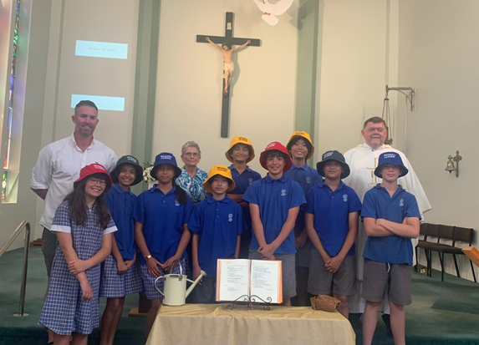
Year 8 Leaver’s Profile
They will show…
Love by accepting and celebrating differences.
respect for each other and the environment through their words and actions.
kindness and fairness in their relationships and gratitude for all they have.
generosity by reaching out to those less fortunate.
empathy to everyone they meet.
resilience to deal with difficult situations.
perseverance when things are difficult
A love of learning in all aspects of their lives.
Our St Francis School Year 8 students will have …..
A love of God, secure in the knowledge that they are loved unconditionally and part of God’s plan for them.
A love and appreciation of learning and how it never stops.
A strong sense of self and the ability to discern and act on what is right.
A developing knowledge and commitment to the beliefs and practices of their faith
An attitude of service and love for others grounded in the principles of Catholic Social teaching.

